Slide 1
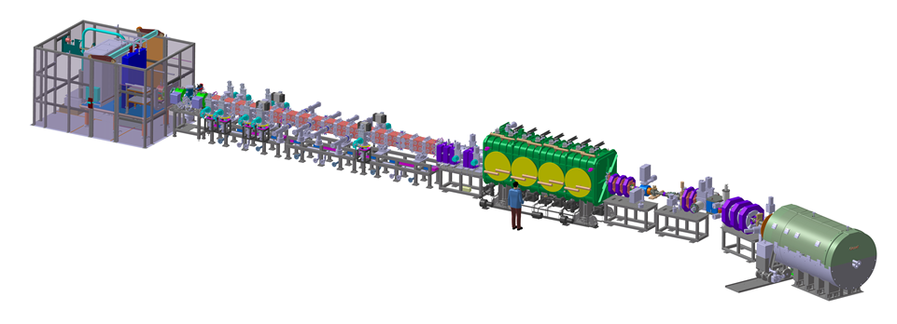
LIPAc status report EPICS Integration and Commissioning + RFQ LCS status at INFN/LNL Alvaro Marqueta LIPAc Project Team on behalf of the LIPAc Control Systems family
36 m
EPICS Fall Meeting 2014, Saclay

Slide 2
Introduction to IFMIF/LIPAc
LIPAc -> Linear IFMIF Particle Accelerator
IFMIF -> International Fusion Materials Irradiation Facility
(the fusion relevant neutron source)

Slide 3
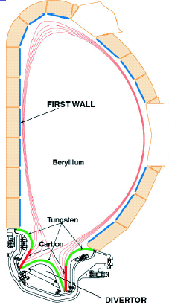
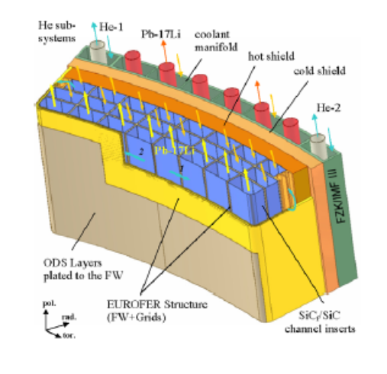
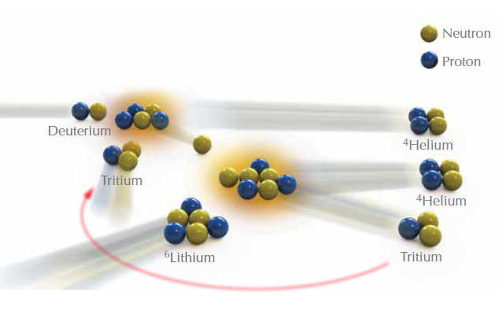
Neutrons in first wall
ITER first wall will present
<2 dpa at the end of its operational life
In a Fusion power plant
~150 dpa within 5 years are expected
Existing neutron sources do not provide the needed answers
Section of Vacuum Vessel
of a Tokamak
The first wall
of the reactor vessel shall
absorb neutrons energy
and
breed tritium

Slide 4
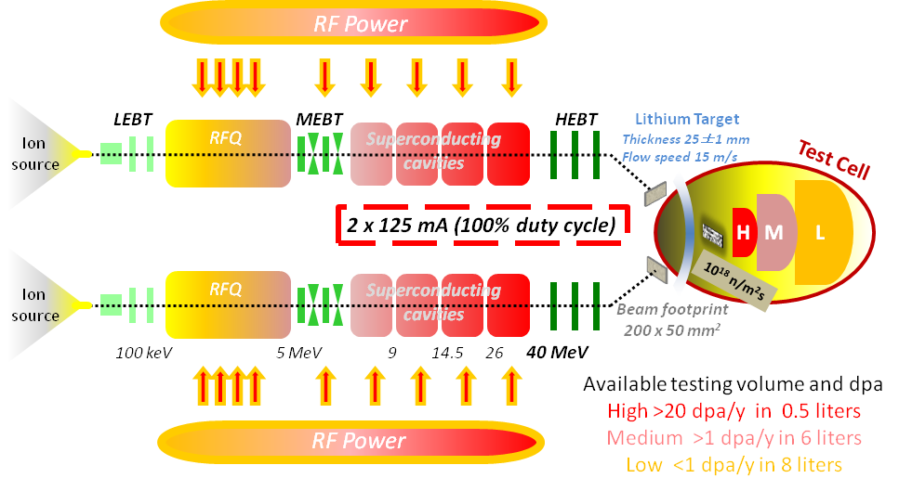
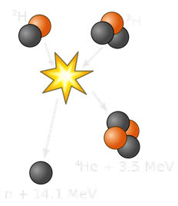
IFMIF concept
Deuterons at 40 MeV
collide on a liquid Li screen
flowing at 15 m/s
A flux of 10¹⁸ n·m⁻²s⁻¹
is stripped
with a broad peak
at 14 MeV
EVEDA Phase: LIPAc

Slide 5
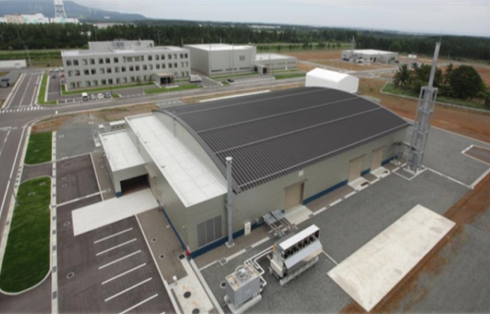
EVEDA phase: LIPAc
Accelerator facility validation
★
Rokkasho
Installed and commissioned in Rokkasho
Injector + LEBT
CEA Saclay
RFQ
INFN
JAEA Tokai
SRF Linac
CEA Saclay
CIEMAT Madrid
MEBT
CIEMAT Madrid
HEBT
CIEMAT Madrid
BD
CIEMAT Madrid
36 m
Diagnostics
CEA Saclay
CIEMAT Madrid
RF Power
CIEMAT Madrid
CEA Saclay
SCK Mol

Slide 6
IFMIF/LIPAc Main Actors
IFMIF/EVEDA
A fruitful Japanese- European International collaboration
(under the Broader Approach Agreement)
LIPAc contributions:
Japanese
implementing agency
European
implementing agency
Central systems:
Network infrastructure
Central control system
Machine Protection system
Personnel Protection system
Timing system
(European coordinator)
Local control systems:
Injector + LEBT
RFQ
LLRF
MEBT
+ (…)
Beam Instrumentation

Slide 7
Overview of LIPAc Control Systems
MPS
Central Control System
PPS
EPICS
Environment
LAN
Local Control Systems
Injector + LEBT
CEA Saclay
RFQ
INFN
JAEA Tokai
RFQ
SRF LINAC
RF Power
Injector
LLRF
MEBT
HEBT
Beam Instrumentation
SRF Linac
CEA Saclay
CIEMAT Madrid
MEBT
CIEMAT Madrid
Hardwired Environment
HEBT
CIEMAT Madrid
BD
CIEMAT Madrid
Diagnostics
CEA Saclay
CIEMAT Madrid
RF Power
CIEMAT Madrid
CEA Saclay
Timing System

Slide 8
Overview of LIPAc Control Systems
LIPAc Control System:
Main characteristics
Modular design, following the architecture of the whole LIPAc, based on procurement ‘in-kind’:
independent subsystems with common interface.
Based on EPICS and CSS for software applications (OPI, archiving, alarms…)
common standardized EPICS platform
Around 20.000 process variables managed globally
considered medium size facility
MPS fastest response (beam shutdown, hardwired loop) of around 20us
But also has to manage slower PLC signals

Slide 9
Local Control Systems
Standard LCS architecture (standalone configuration)
European contribution, coordinated by CEA
EPICS standardization though guidelines, common EPICS/CSS platform
Delivered in local configuration to Rokkasho (to undergo acceptance tests before integration)
EPICS
Apps
OPC
Server
S7 Protocol
Channel Access Protocol
VME
PLC
Modbus TCP
I/O signals
Profibus DP
I/O signals
Field equipment
(fast process)
Field equipment
(slow process)
Notes:
Developed independently by each institute
According to common guidelines, that specify hw and sw and interfaces
Designed to be able to operate in stand-alone mode (for individual system test – pre commissioning)
But will be all coordinated from control room (CCS)

Slide 10
LIPAc Schedule
2014
2015
2016
LIPAc Phase #1
Injector checkout
Beam commissioning
LIPAc Phase #2
RFQ Installation
MEBT & D-plate Installation
Phase #2 commissioning
LIPAc Phase #3
HEBT & Bdump Installation
SRF Linac Installation
Phase #3
commissioning
LIPAc Phase #4

Slide 11
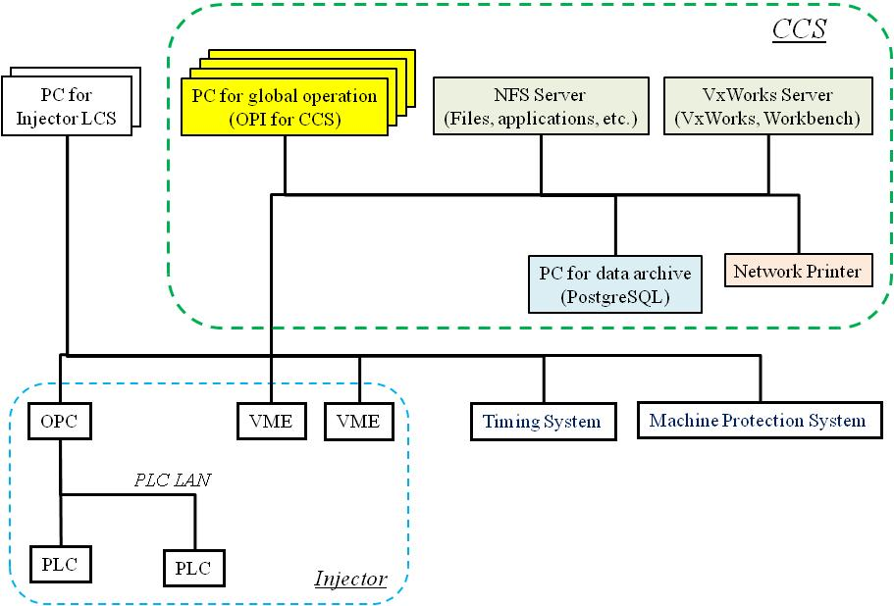
Overview of LIPAc Control Systems
LIPAc Central Control System (Phase I):
Courtesy of:

Slide 12
Central Control System Outline
CCS will consist of a number of services…
CCS
Local + Global OPIs, with key parameters from each LCS, global permits, etc.
Centralized alarm manager, thus integration of all alarms from LCSs + actions
Centralized archiving system, logging all EPICS variables (inc. MPS/PPS)
Server for SNL execution
+ management of Operation States
Operator applications environment, still to be decided… + SVN manager

Slide 13
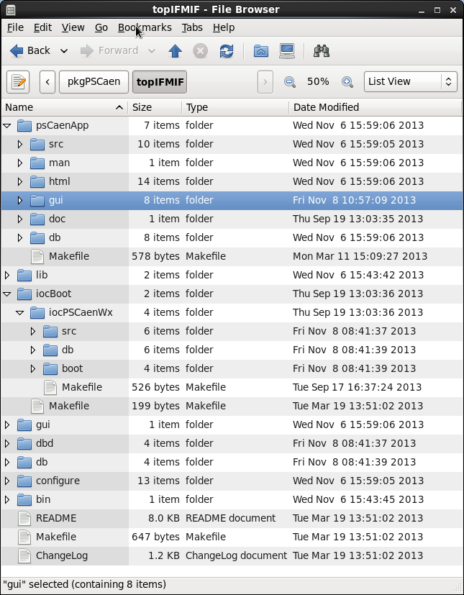
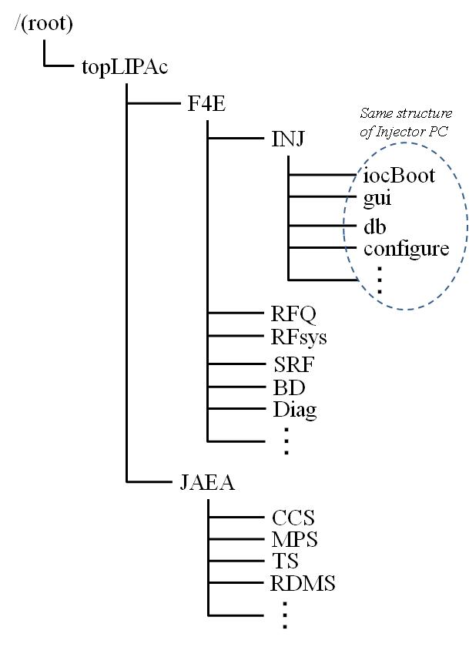
EPICS integration: topIFMIF tree
Application tree (Db, Gui, etc…)
IOC tree
All GUIs
All database files (Db)
Configuration files of topIFMIF

Slide 14
Local Control Systems
CCS
EPICS Servers
LCS Integration Process
EPICS
Apps
OPC
Server
switch
S7 Protocol
Channel Access Protocol
VME
PLC
Modbus TCP
I/O signals
Profibus DP
I/O signals
Field equipment
(fast process)
Field equipment
(slow process)

Slide 15
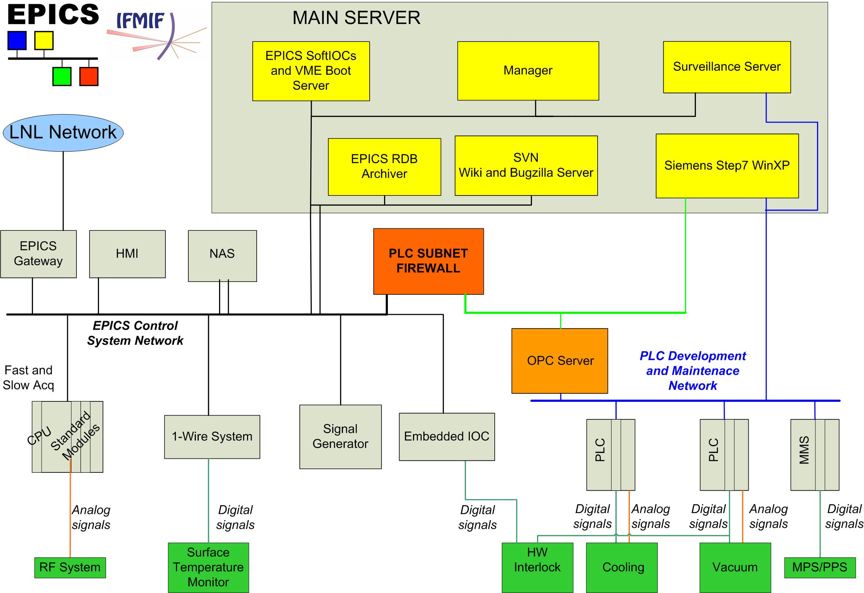
RFQ LCS Architecture
Notes:
Manager: Deploy a ready to use IFMIF/EVEDA machine, fully equipped and fully configured as requested from the project.
More than this, the Manager makes incremental and full backups >> This means a possibility to have a complete disaster recovery solution to IOCs and HMIs
EPICS RDB : This is an EPICS archiver engined by Postgresql
Surveillance server: Using a plugin developed by me time ago[1], it monitors the most important PVs and make possible, to the person on shift, understand where the faults comes
The documental server: it offer, the classical SVN, bugzilla (bug tracker), wiki the documental collaborative tool
EPICS softIOCs & boot: play the role to softIOC server, more, is used to boot other IOCs
Siemens server: is a PC workstation to make easy the maintenance tasks to the PLCs used
NAS: is a Network attached storage which contains the backups
The PLC firewall is used to avoid virus intrusion from the control system network (stuxnet docet)
Numbers:
1.8K PVs
20 EPICS DBs
4 softIOCs: iocPWRCalcs, iocPWRSurfTempMonitor, ioccooling_debug, iocSMA100A
1 IOC su OPCserver
1 IOC su VME
2 IOCs su MicroIOCs
Total amount 9 IOCs
NB The double black lines means a bonding ethernet connections
[1] https://accelconf.web.cern.ch/AccelConf/ica07/PAPERS/TPPA32.PDF

Slide 16
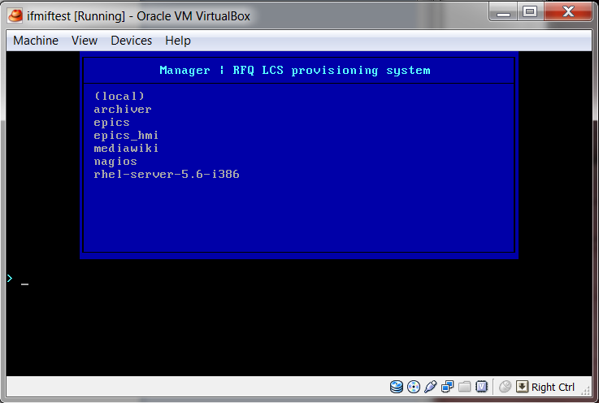
Service: provisioning system
Notes:
This is the window showed if you boot by PXE a just arrived PC workstation on the RFQ LCS network:
just selecting which kind of machine do you want create, in 10 minutes you could have that one ready to use.

Slide 17
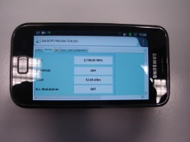
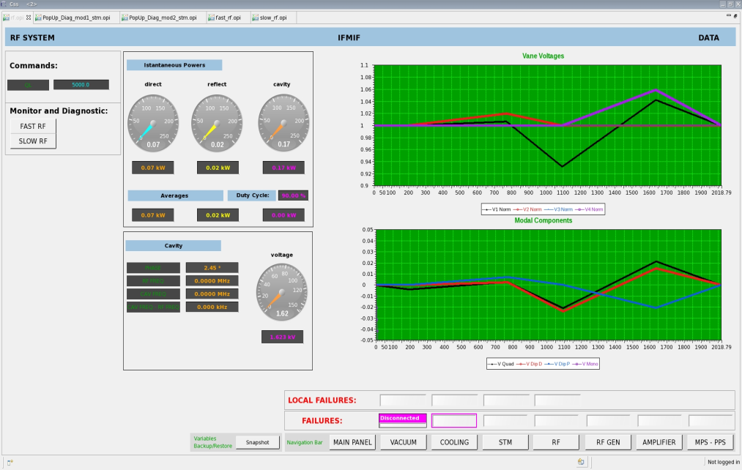
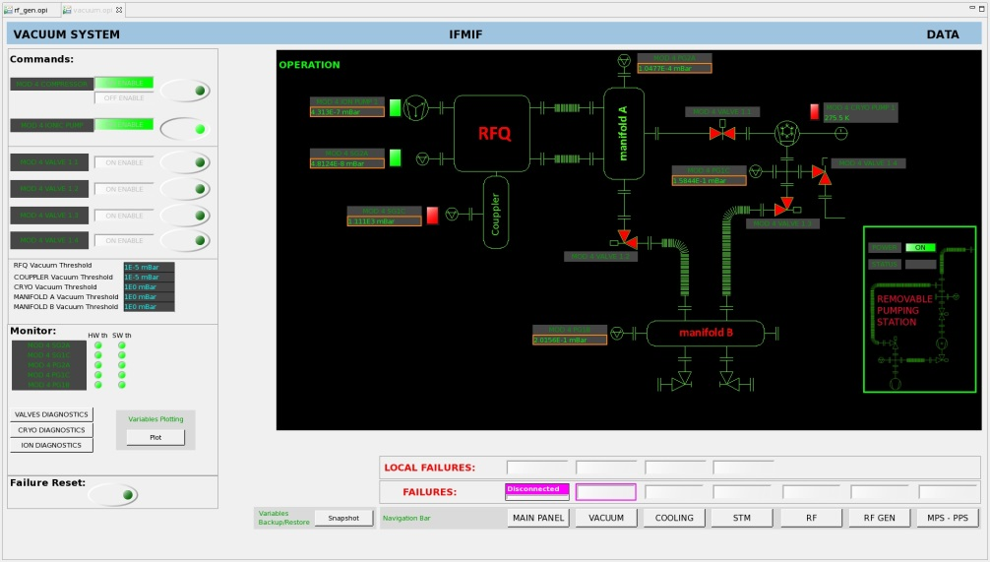
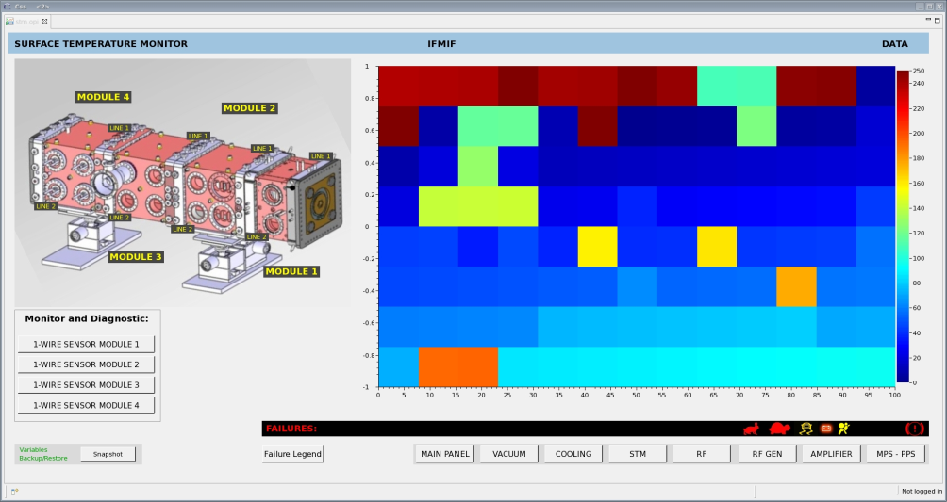
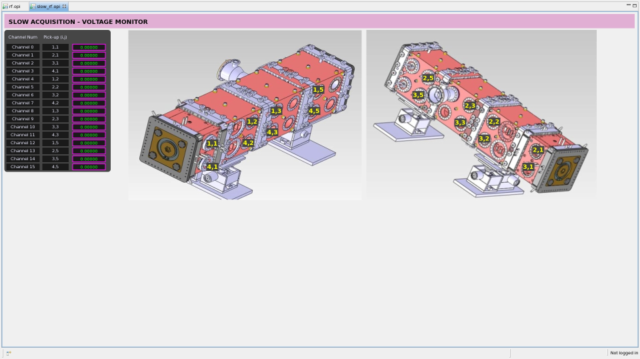
EPICS GUIs
Notes:
432 1wire temperature sensors to power tests (multicolored graph)

Slide 18
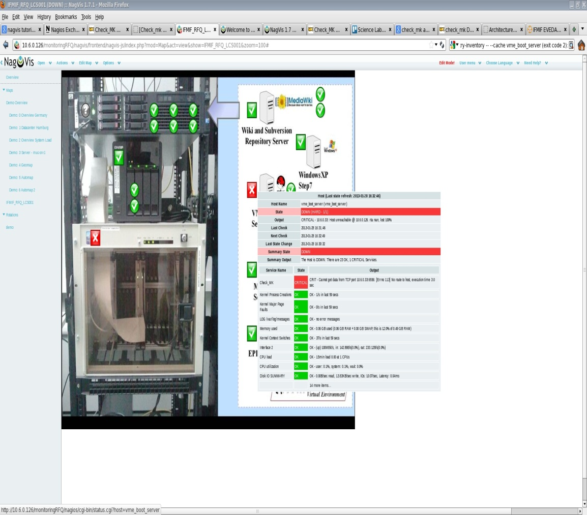
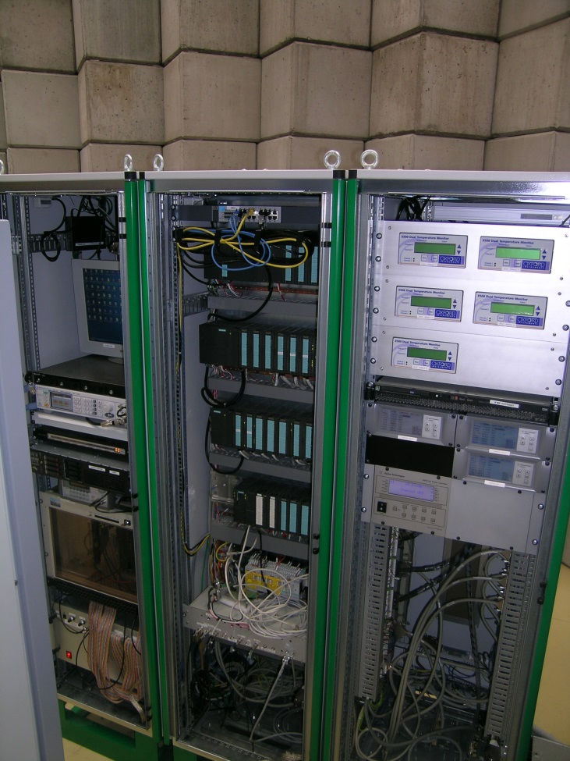
Service: Surveillance

Slide 19
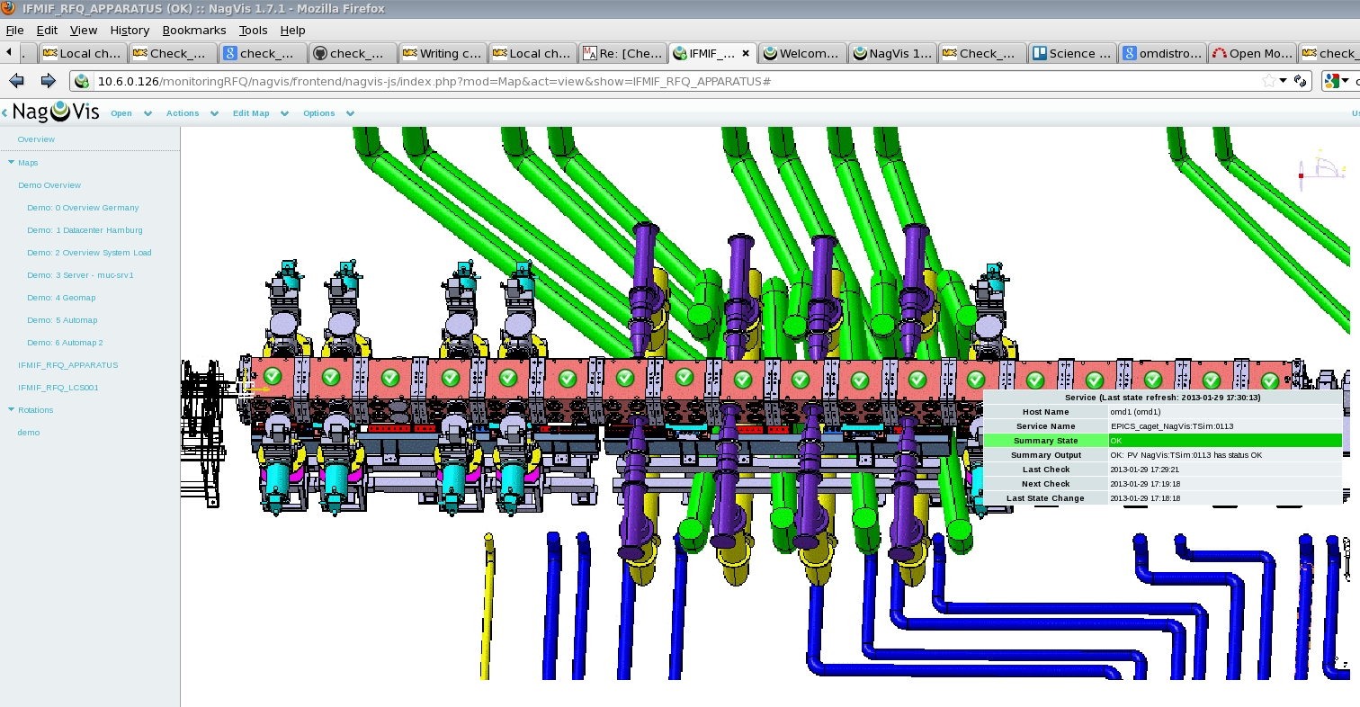
Service: Monitoring
Possibility to check EPICS Variables
Detailed Information
Special thanks to Mauro Giacchini and his team…

Slide 20
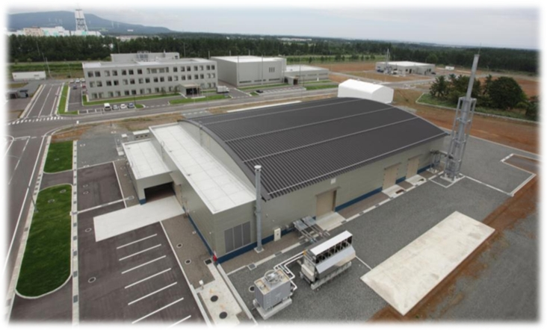
Thank you
Thank you for your attention
www.ifmif.org
Follow us at wikipedia!

